Slide 1
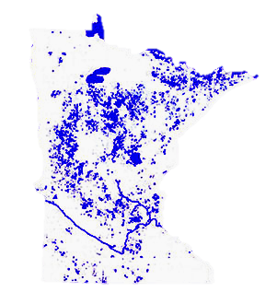
MinneMUDAC 2016
University of Minnesota Duluth
Alex Chun, Isabel Ma, Nathan Oh, Alex Passofaro, Joseph Paulsen, Daniel Peters, Rachel Pompa, Anthony Salls, Torri Simon, Marcus Walker, Jiawei Yu
Advisors: Tracy Bibelnieks, Nik Hassan, Aaron Shepanik,
Notes:
NAME

Slide 2
What we were given:
Goals:
Tax data
Water data
Reference data
Identify relationships between tax and lake quality
Uncover insights

Slide 3
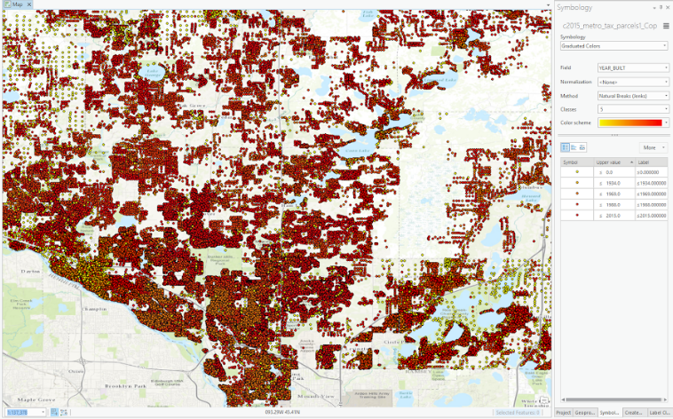
Where Did We Start?
ArcGIS
Visualized tax and water data to create a plan for processing data
Split team to understand and
process tax and water data
separately

Slide 4
Understanding Tax Data
Non-unique latitude and longitude pairs (one-to-many)
Massive dataset (1 to 2 million rows per year)
Land use categories non-standard (~400 types)
More attributes than those of interest for this challenge
Years 2002 to 2004 were very different from other years
Notes:
Roughly ⅔ of fields eliminated

Slide 5
Processing Tax Data
Turning latitude and longitudes to primary keys was unsuccessful
Used R and Tableau to handle size of datasets
Implemented Perl regex to standardize land use into five categories
Reduced number of attributes to those we intended to analyze
Use description, market value, tax, tax exempt, latitude and longitude
parc code
green acre
Condensed timeframe to 2005 - 2014
Notes:
Roughly ⅔ of fields eliminated

Slide 6
Understanding Lake Data
Dataset available from 1980 to 2014
Extremely sparse
Lakes had several measurements in any given year - Number and type was inconsistent from lake to lake
Phosphorous outliers
Not all lakes had seasonal lake grade in every year

Slide 7
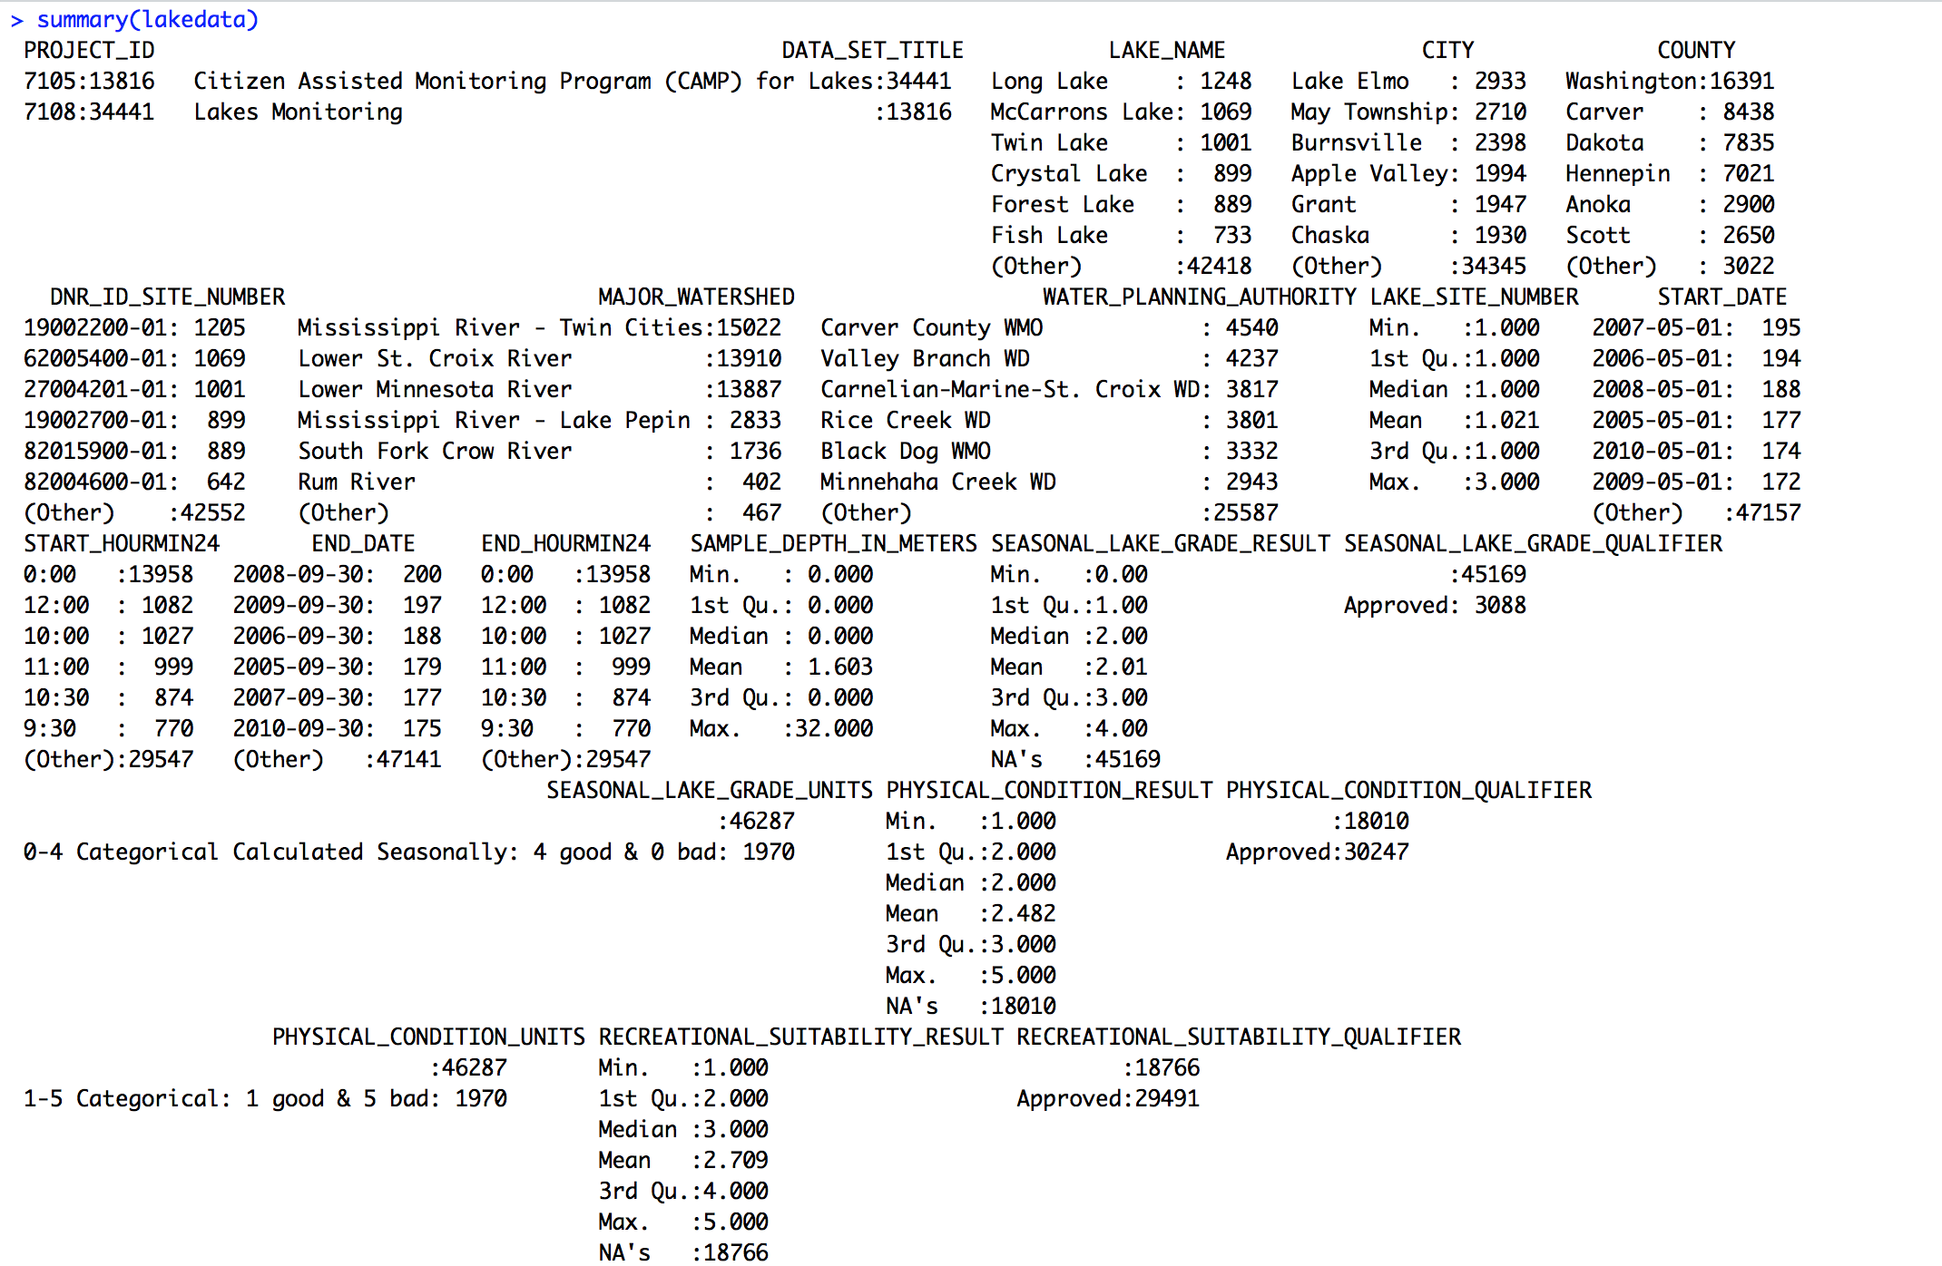
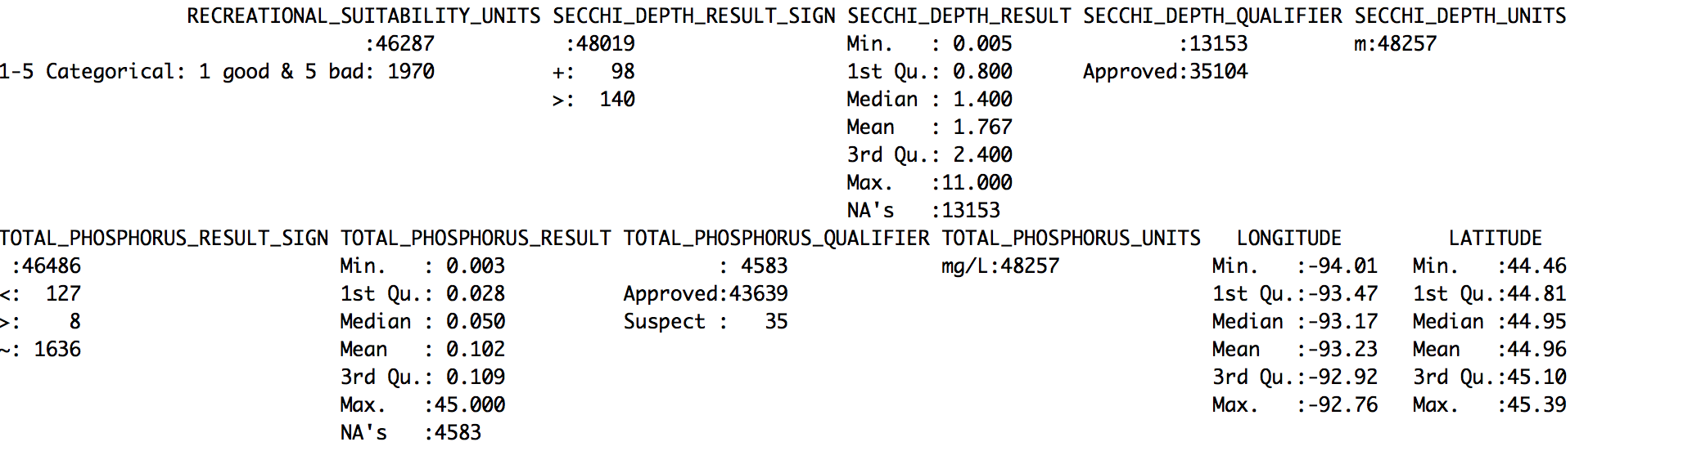
Notes:
Add border to 2nd image

Slide 8
Processing Lake Data
Watershed Trends
Identify lakes with consistent seasonal lake grade over time
Focus on consistently good and bad lakes
Reasonable file size - data refining was not required

Slide 9
Bad Lakes (Seasonal Lake Grade <=1 consistently from 2005-2014) |  | Good Lakes (Seasonal Lake Grade >= 3 consistently from 2005-2014)
Alimagnet Bay Pond (starts at 2006) Benton Benz (goes to 2012) Cobblecrest (goes to 2013) Colby Cornelia Downs Eagle East (goes to 2013) Farquar George Watch (goes to 2013) July (starts at 2006) | Lynch (starts at 2006) Markgraf McKnight (starts at 2006) Miller Swede | Bass Big Carnelian Big Marine Brickyard Clayhole Bush Cates (stops at 2013) Cloverdale (stops at 2013) Courthouse DeMontreville East Boot Edith (starts at 2005) Elmo (starts at 2005) | Fireman’s Clayhole Halfbreed Kingsley Lac Lavon Little Carnelian Lower Prior Olson Orchard Pine Tree Square St. Joe Sunset Lake Sunset Pond Terrapin West Boot
Notes:
Split into two tables on two slides w/ visual accompaniment

Slide 10
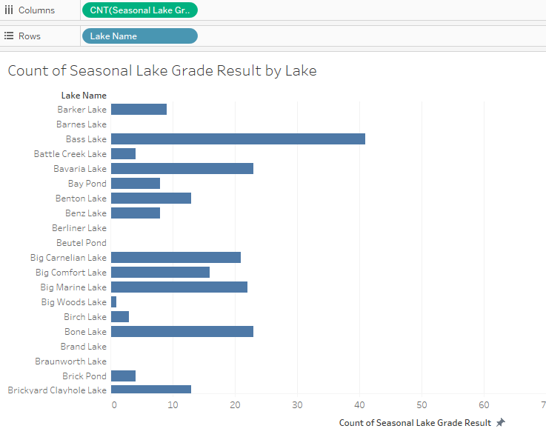
Dealing with Sparseness and Seasonal Lake Grade
Notes:
This visual is misleading since the tooltip is not about the anomalous point

Slide 11
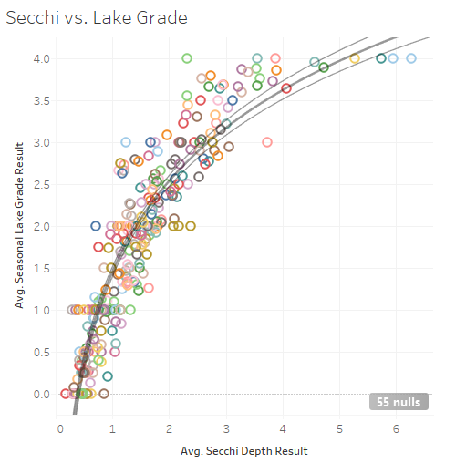
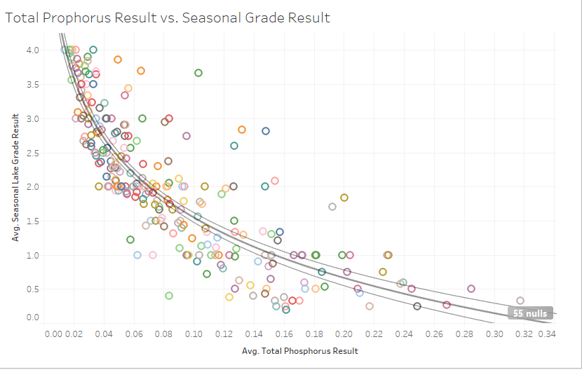
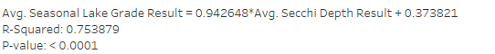
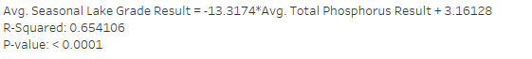
Secchi and Phosphorous as Potential Substitutes
Notes:
Secchi and Phosphorous as potential substitute for seasonal lake grade.

Slide 12
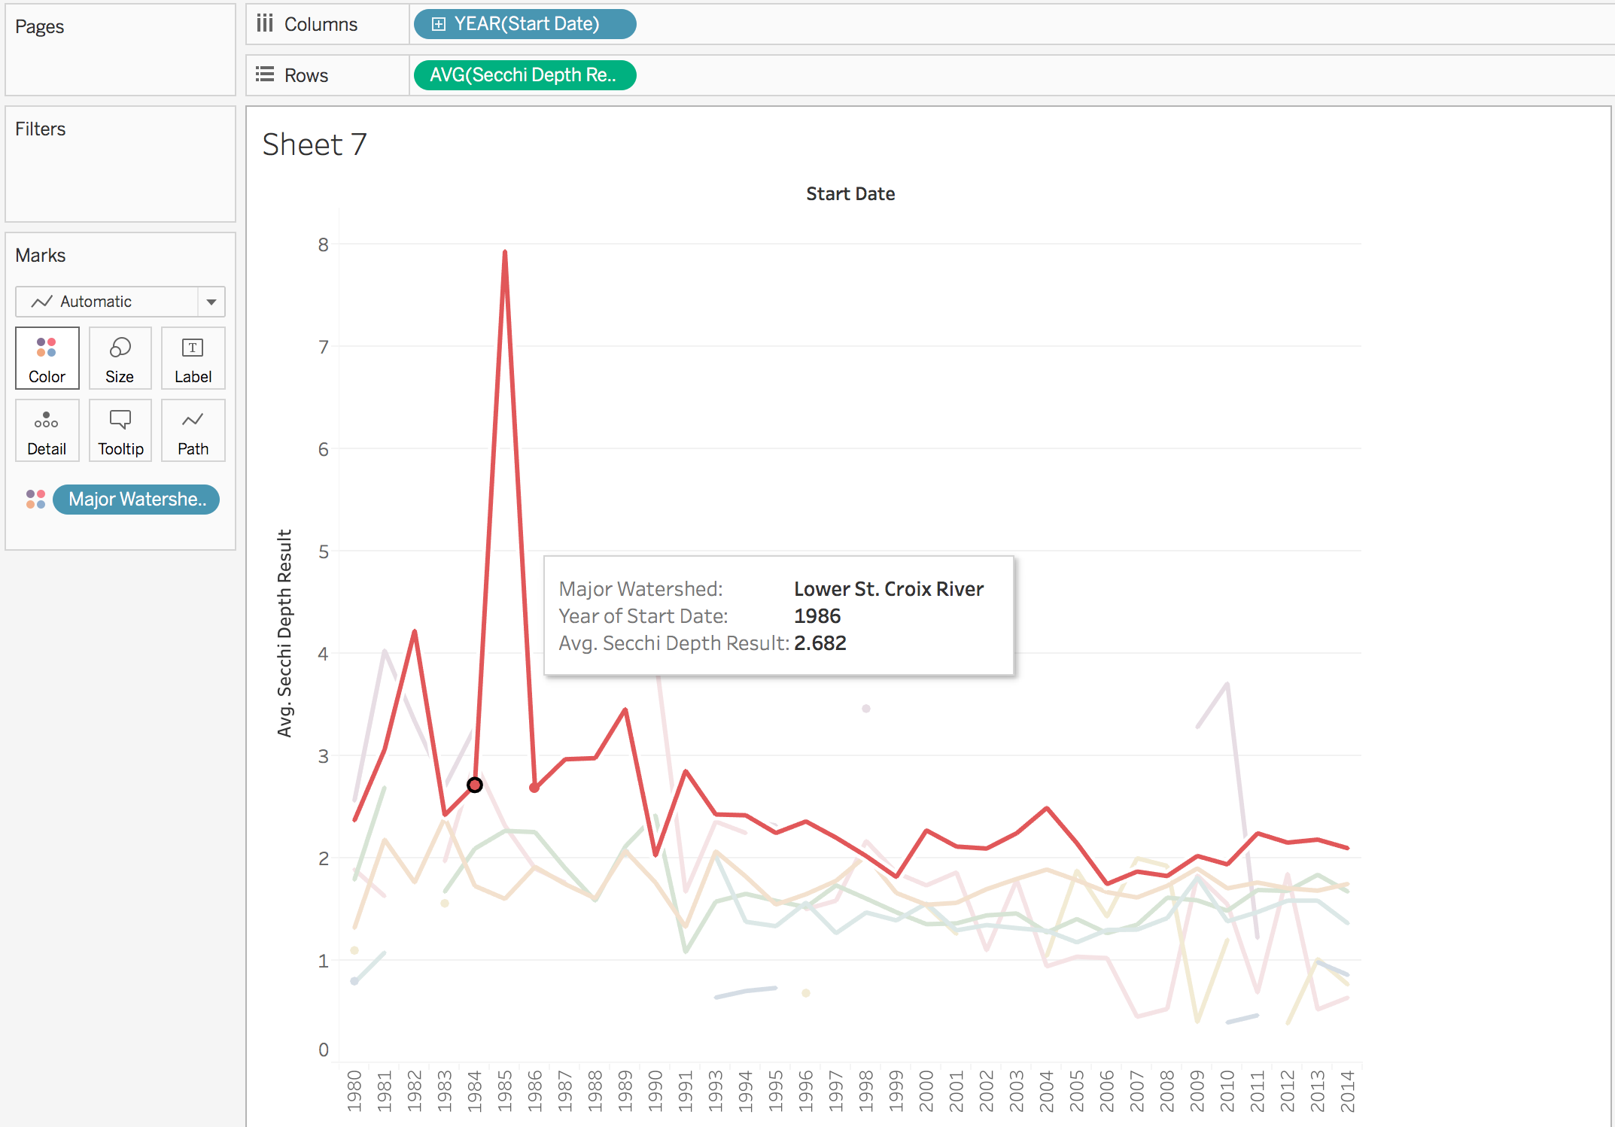
Best Watershed by Secchi Depth
Used secchi depth to offset sparseness in seasonal lake grade data
Lower St. Croix River
consistently better than
other 7 watersheds
Notes:
This visual is misleading since the tooltip is not about the anomalous point

Slide 13
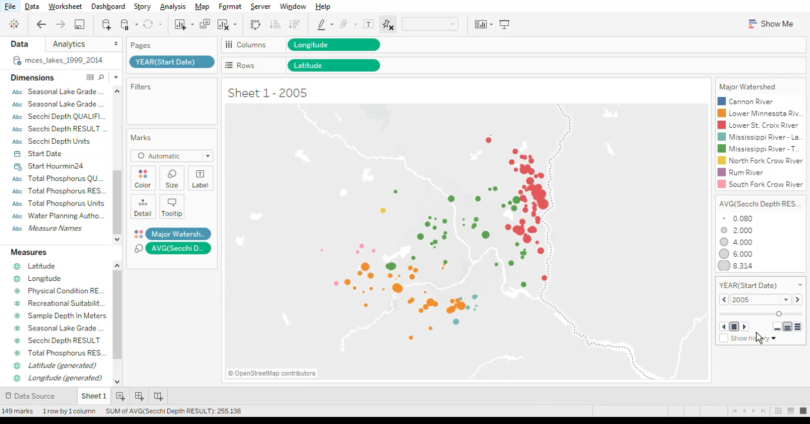

Slide 14
Joining Tax and Lake Data
Join data and export for analysis in other software
R
Data file sizes still a challenge
Software couldn’t handle parcel to water data file size
Software limitations
R virtual memory limit
Access max database limits
Oracle time limitations
Defaulting to Tableau
Not possible to export as universal file type
Performed analysis in Tableau

Slide 15
Research findings
There are many things that affect the water quality, and the land use is the most important factor to control the water quality (Tong et al., 2002). It is because the chloride and nitrite-nitrogen concentrations have been increasing much more than the nature did as the industry developed (Keeler and Polasky, 2014).
In terms of the land prices, it is concluded that the land price decreases as being closer to the contamination site. In addition, people concerned more on the well contamination than on the groundwater contamination, even though the groundwater contamination can cause long-term health problems (Chamblee, 2015). For people who live near the surface water, people were willing to pay more for the clearer water (Clapper and Caudill, 2014).
Chamblee, John F., Carolyn A. Dehring, Craig A. Depken, II, and Joseph R. Nicholson. "Water Contamination, Land Prices, and the Statute of Repose." J Real Estate Finan Econ 51 (2015): 398-414. Web.
Clapper, Julia, and Steven B. Caudill. "Water Quality and Cottage Prices in Ontario.” Applied Economics 46.10 (2014): 1122-126. Web.
Tong, Susanna T.Y., and Wenli Chen. "Modeling the Relationship between Land Use and Surface Water Quality." Journal of Environmental Management 66.4 (2002): 377-93. Web. 20 Oct. 2016.
Keeler, B. L., & Polasky, S. (2014, January 30). Land-use change and costs to rural households: A case study in groundwater nitrate contamination. IOP Science, 9(7).

Slide 16
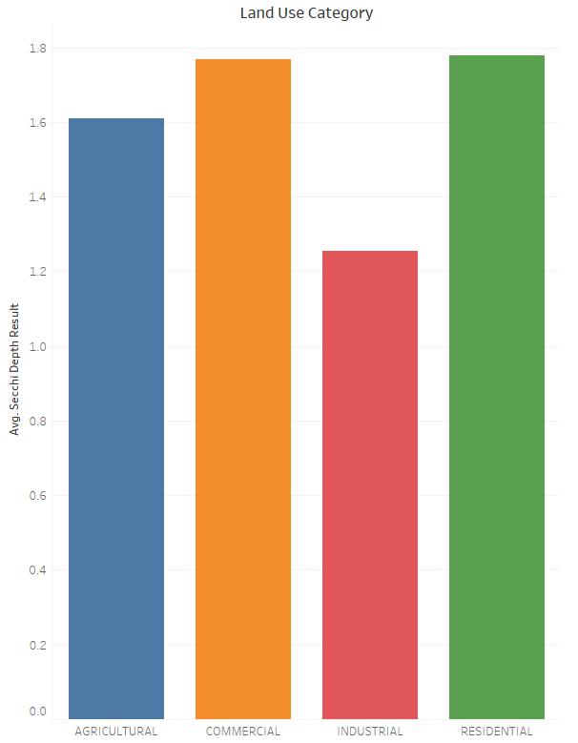
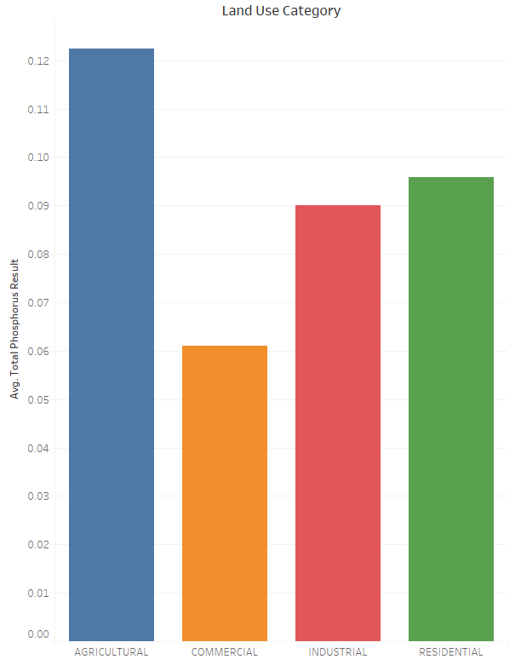
Land Use and Secchi Depth
Relationship between Land Use and Secchi Depth, Phosphorous explored
Viewing tax parcels within 150 meters of lake edge.
Herbicide and pesticides used in agriculture, waste from residential properties liekly contribute to phosphorous levels
Notes:
We took out 2008 and 2009 tax data

Slide 17
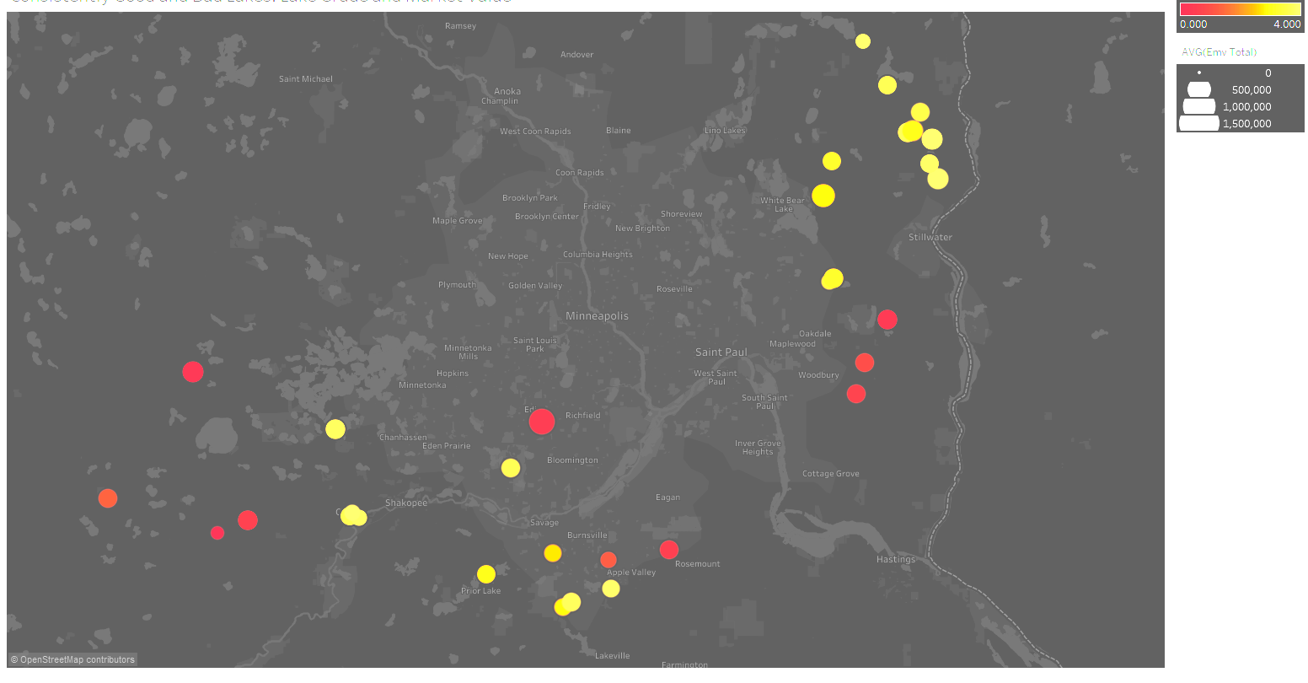
Consistently Good and Bad Lakes v. Ave Market Value

Slide 18
Further Direction
Machine learning application
Join tax and lake data
Use decision tree algorithm to produce predictive models
Predict seasonal lake grade, phosphorus, secchi depth, etc using tax parcel data
Create interpolating predictive models to approximate missing data
Appending other data
Lake morphology
Census data – correlatoin between median income and lake quality, population density
Remote sensing data – leaf area index
Economic indicators
Adjusting tax data for 2008 housing market crash

Slide 19
Lessons we learned about data science:
Value of a cross-disciplinary team (MIS and Mathematics/Statistics)
Realities of “Big Data in the Wild”
The inadequacy of student-accessible software (and hardware) to handle large datasets
Data science is complex in a good way

